Slide 1
UK Fisheries through a socio-economic lens
25 February 2020
Fisheries APPG
Griffin Carpenter, Senior Researcher
New Economics Foundation

Slide 2
Features of the resource
Finite
Public
Shared
Uncertain
Political

Slide 3
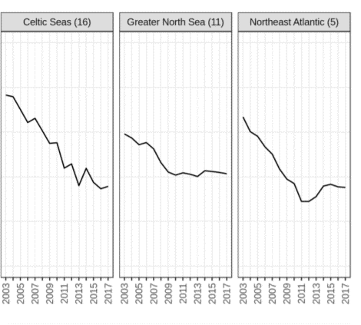
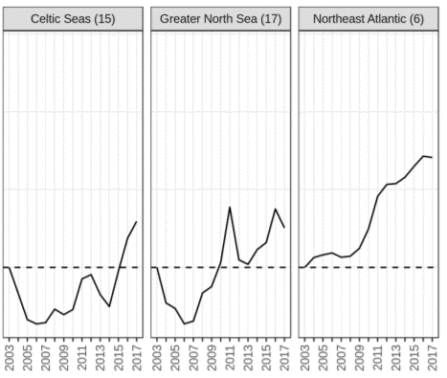
Finite
Rate of overfishing
Abundance of biomass
Scientific, Technical and Economic Committee for Fisheries, 2019. Monitoring the performance of the Common Fisheries Policy (STECF-Adhoc-19-01). Publications Office of the European Union.

Slide 4
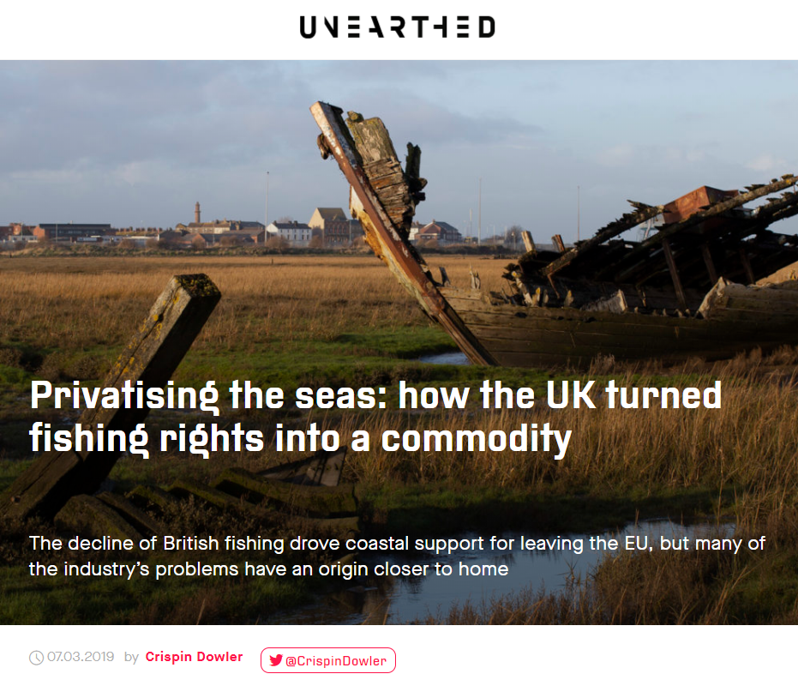
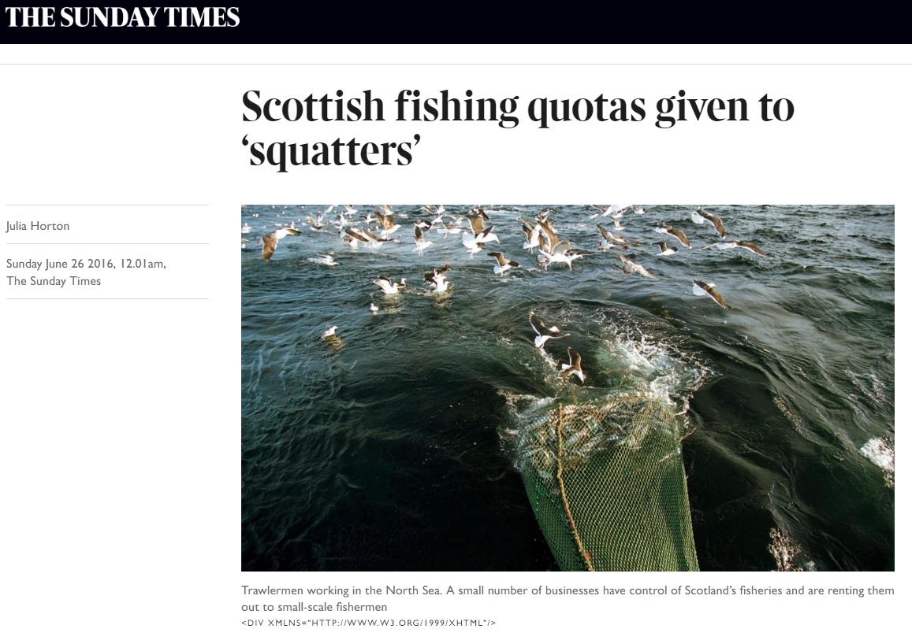
Public

Slide 5
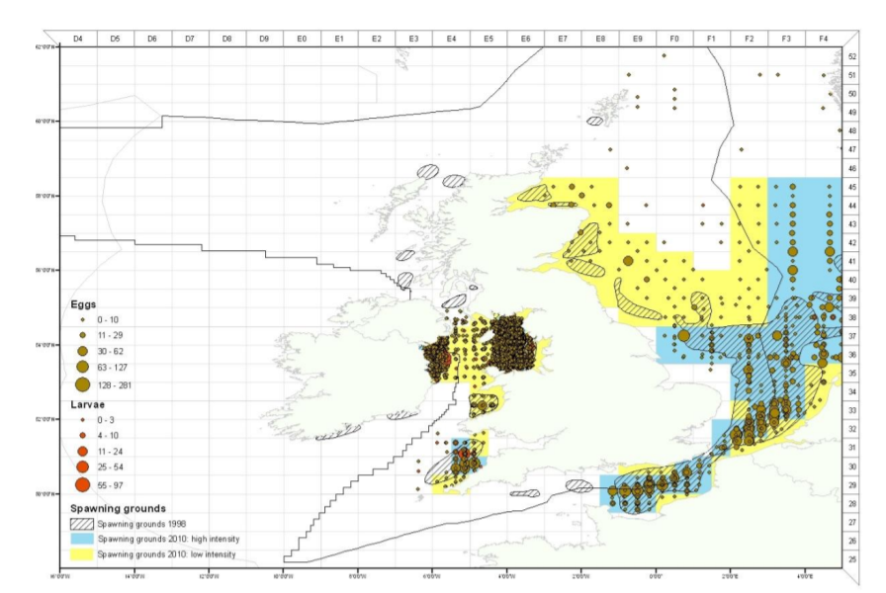
Shared
Centre for Environment, Fisheries and Aquaculture Science, 2010. Mapping spawning and nursery areas of species to be considered in Marine Protected Areas (Marine Conservation Zones). Department for Environment, Food, and Rural Affairs.

Slide 6
Uncertain
Notes:
Cartoons: https://www.cleanpng.com/

Slide 7
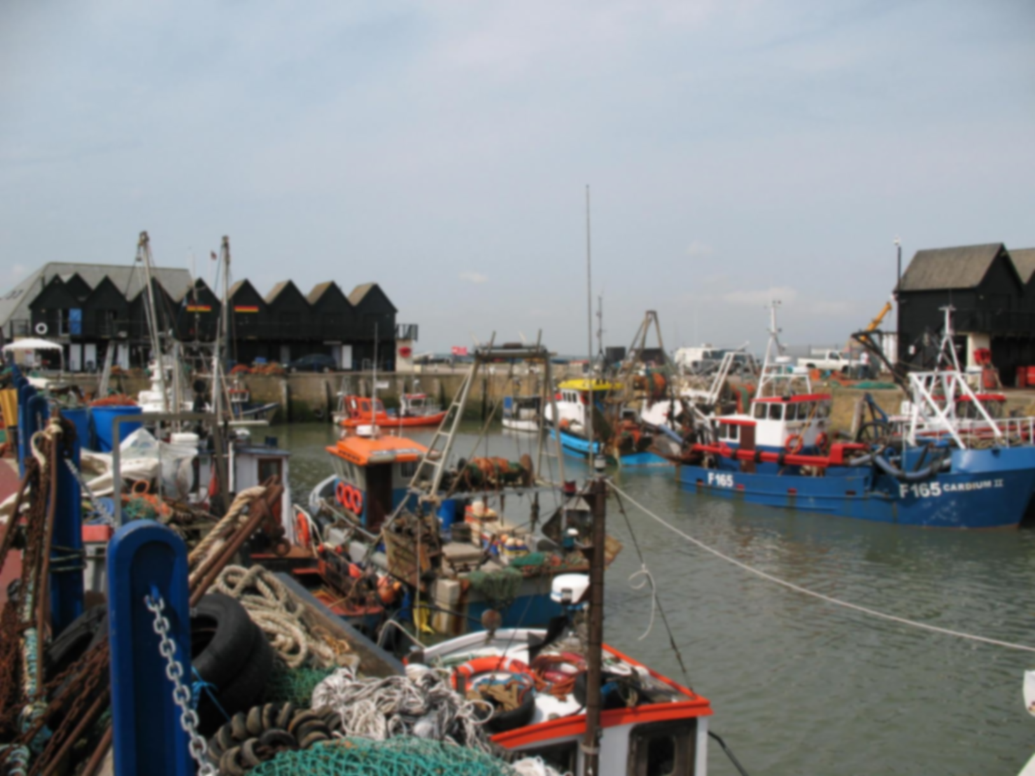
Political
Finite
Public
Shared
Notes:
Photo: https://upload.wikimedia.org/wikipedia/commons/b/b5/Whitstable_Harbour%2C_Kent%2C_UK.jpg

Slide 8
Political
Norway
Pre-EU period
1948-1972
EU ascension
1972-1983
Common Fisheries Policy
1983-2020
Notes:
Graph: Authors’ calculations from MMO and Statistics Norway

Slide 9
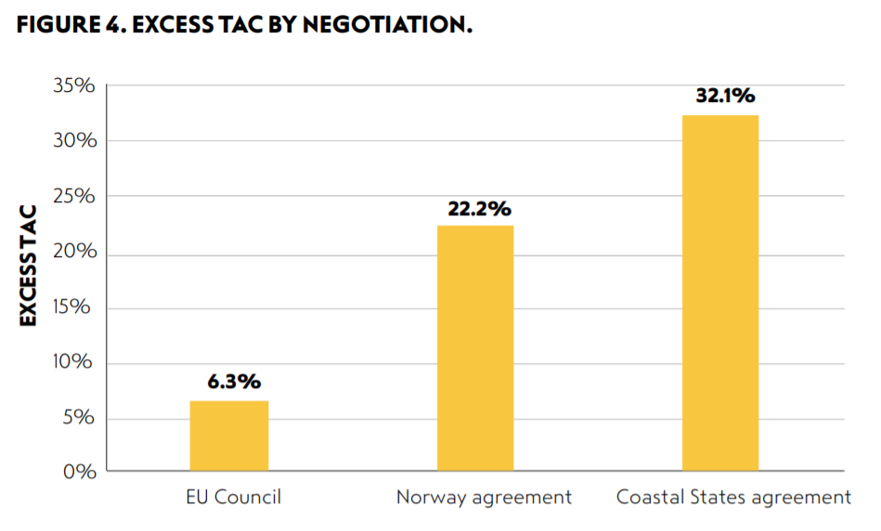
Lessons from independent coastal states: Finite
Carpenter, G. and Heisse, C. 2019. Landing the blame: Overfishing in the Northeast Atlantic 2019. New Economics Foundation.

Slide 10
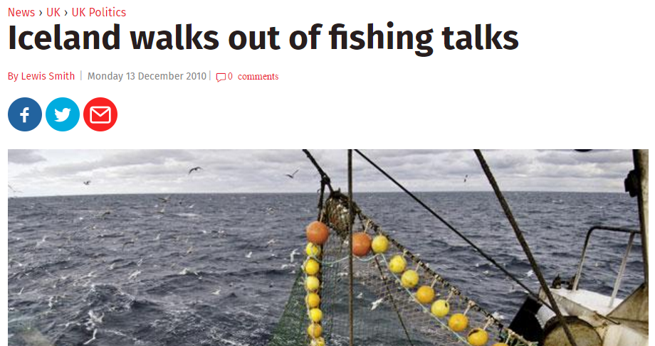
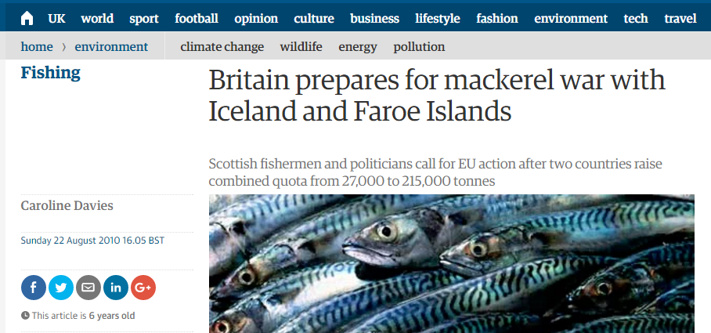
Lessons from independent coastal states: Shared

Slide 11
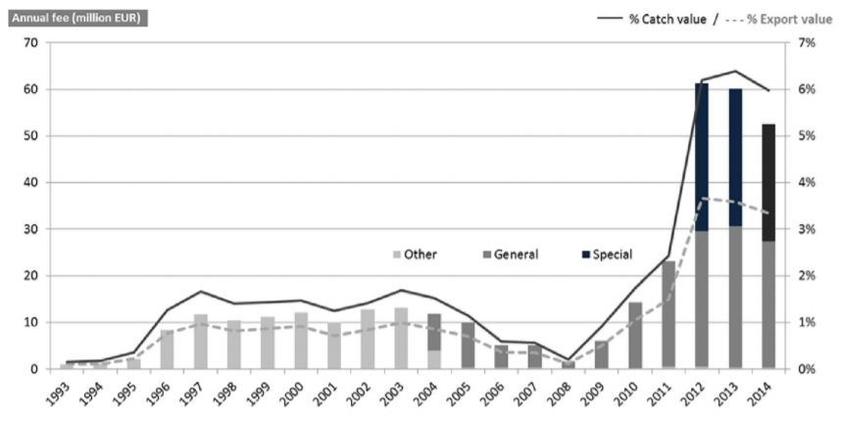
Lessons from independent coastal states: Public
Gunnlaugsson, S.B., Kristofersson, D., and Agnarsson, S., 2018. Fishing for a fee: Resource rent taxation in Iceland’s fisheries. Ocean & Coastal Management (163): pp. 141-150.

Slide 12
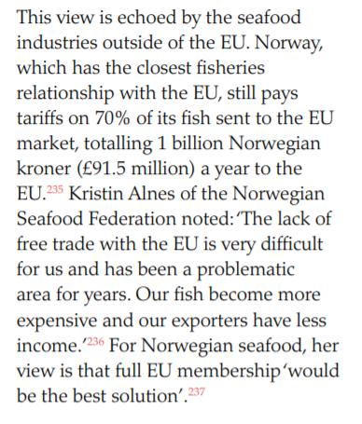
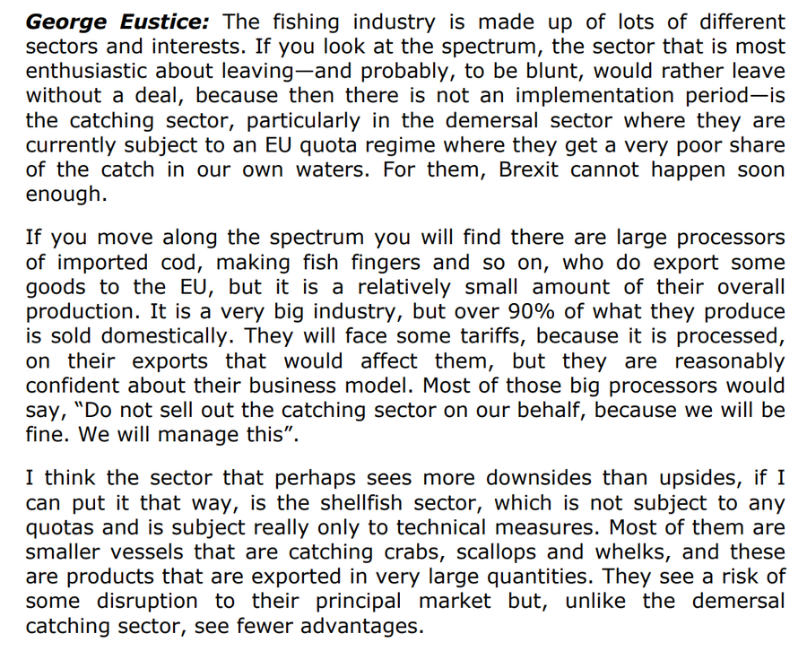
Lessons from independent coastal states: Uncertain
Carpenter, G., 2017. Not in the same boat: The impact of Brexit across UK fishing fleets. New Economics Foundation.
George Eustice speaking at the UK Parliament International Trade Committee: 8 October, 2019.

Slide 13
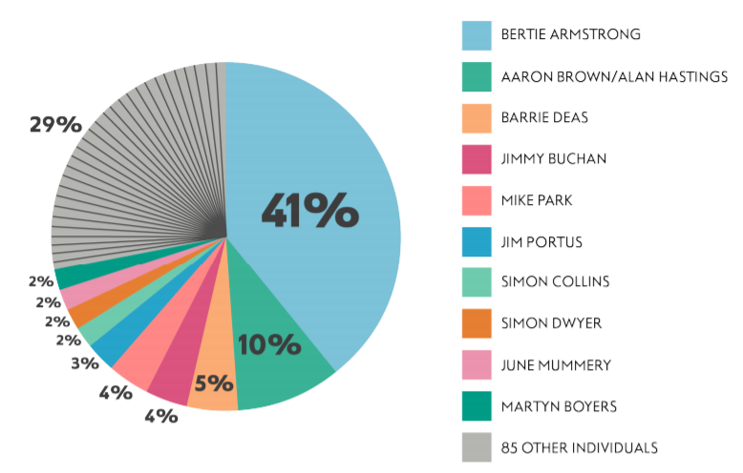
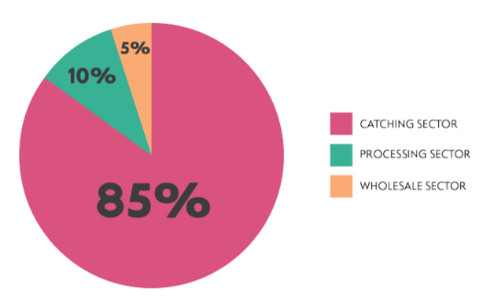
Lessons from independent coastal states: Political
Carpenter, G., Williams, C., and Scurrah, E. 2019. Media capture in UK fisheries. New Economics Foundation.

Slide 14
Implications for the Fisheries Bill & future policy
Finite: debate over legal duty, what’s left to Joint Fisheries Statement
Public: ‘national benefit’ added to Bill, foreign ownership likely unchanged?
Shared: my greatest concern, quota shares agreed by 2021?
Uncertain: need to build socio-economic resilience in secondary legislation
Political: who do we hear from? what are we trying to achieve?

