Slide 1
Economics of UK fishing fleet and processing industry
Arina Motova
Chief Economist, Seafish
25th February 2020, APPG meeting London

Slide 2
Content
UK fishing fleet
Fleet
Landings
Economic performance
Employment & employees
Seafood processing industry
Number of sites and economic performance
Employment & employees

Slide 3
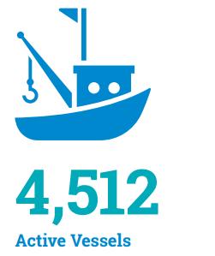
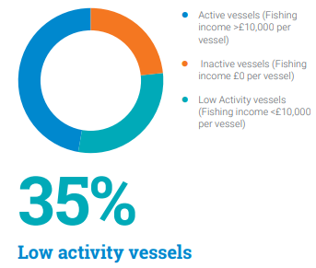
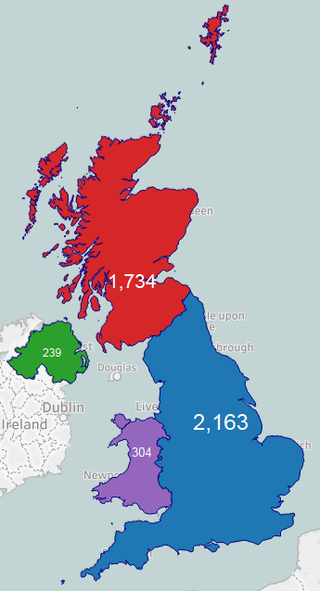
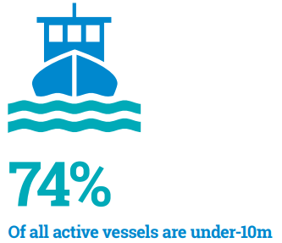
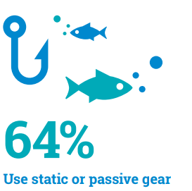
Fleet
Source: Economics of the UK Fishing Fleet 2018, Seafish

Slide 4
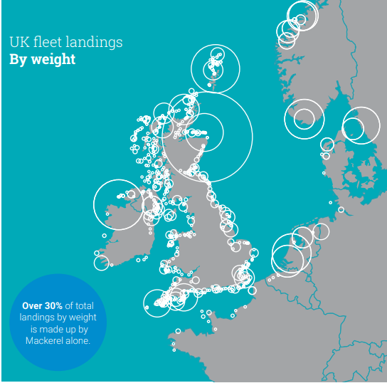
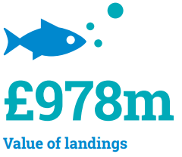
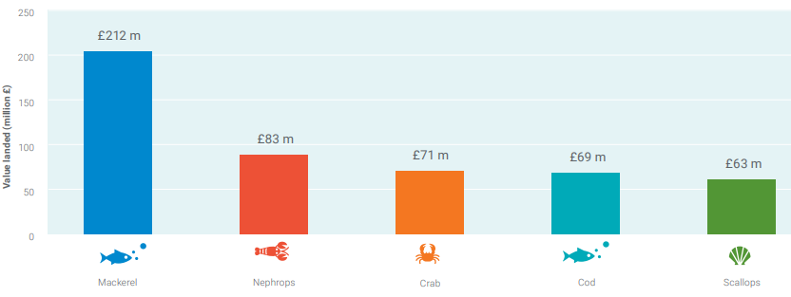
Landings
74% landed in UK
Source: Economics of the UK Fishing Fleet 2018, Seafish
Notes:
74% of value and 62% of weight is landed in UK.
The UK fishing fleet landed nearly 688,000 tonnes of fish and shellfish in 2018. Most landings were made in UK, with Peterhead, Lerwick and Fraserburgh being the main UK landing ports by weight. Landings abroad were mainly in Norway, Denmark, the Netherlands and Ireland.

Slide 5
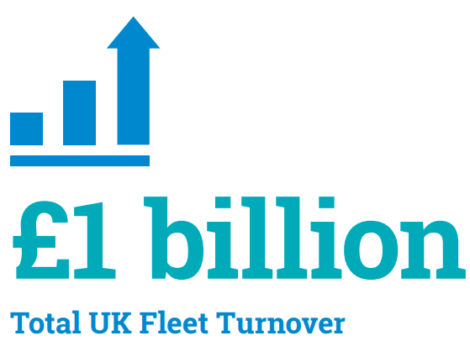
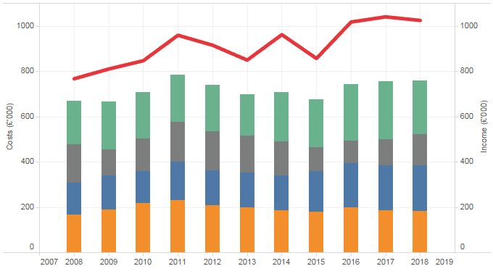
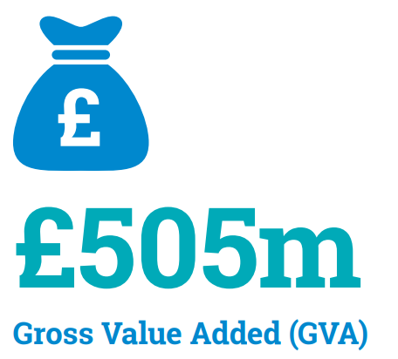
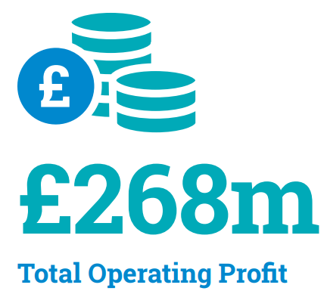
Economic performance
Source: Economics of the UK Fishing Fleet 2018, Seafish

Slide 6
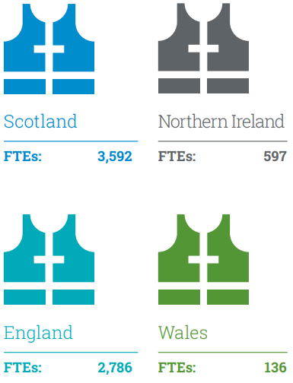
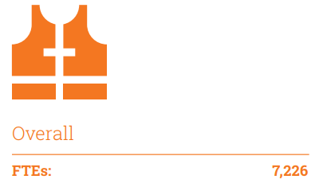
Employment
Number of employees 11,961
*FTE = Full Time Equivalent
Source: Economics of the UK Fishing Fleet 2018, Seafish and MMO

Slide 7
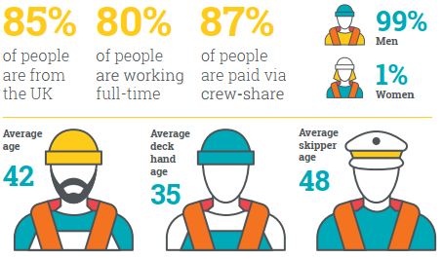
Employees
Source: 2018 Employment in the UK Fishing Fleet, Seafish

Slide 8
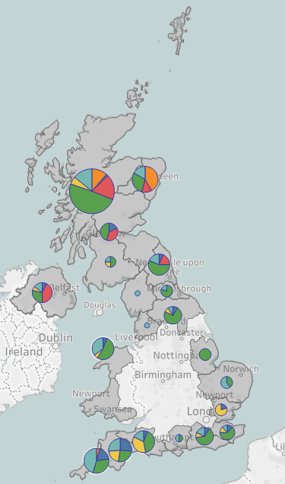
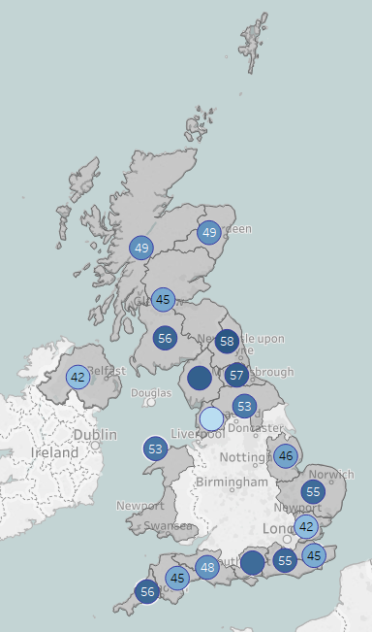
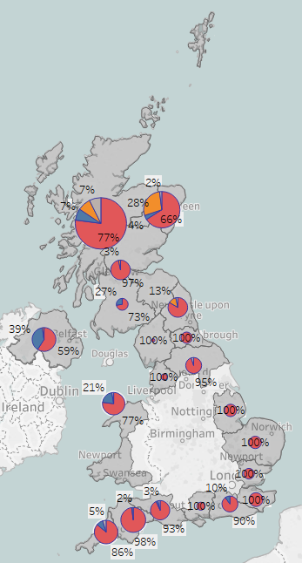
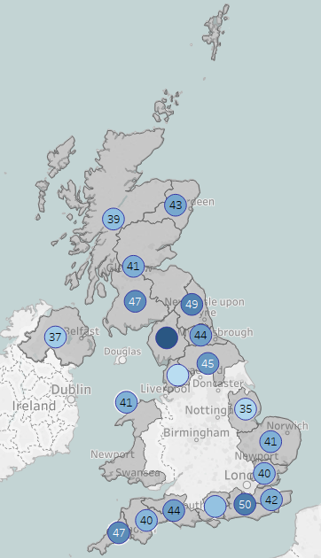
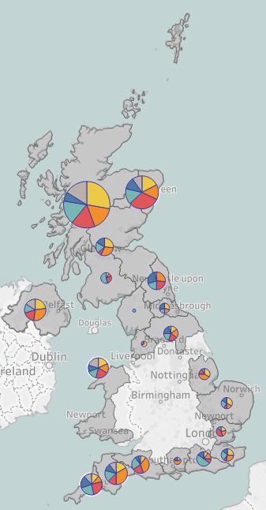
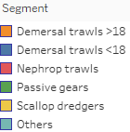
Regional overview
Sample
Number of vessels
Fishers
Age profiles
Fishers
Nationality
Average age
Average owner age
Source: UK socio-economic survey 2018, Seafish

Slide 9
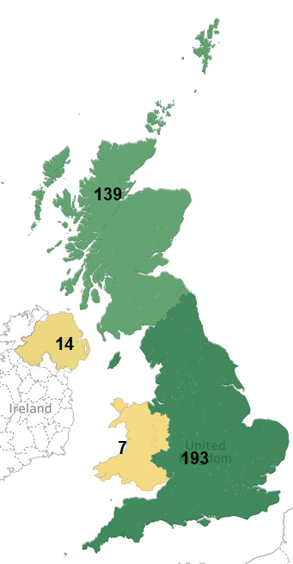
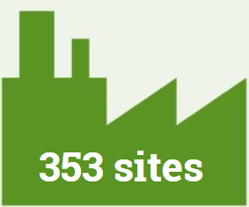
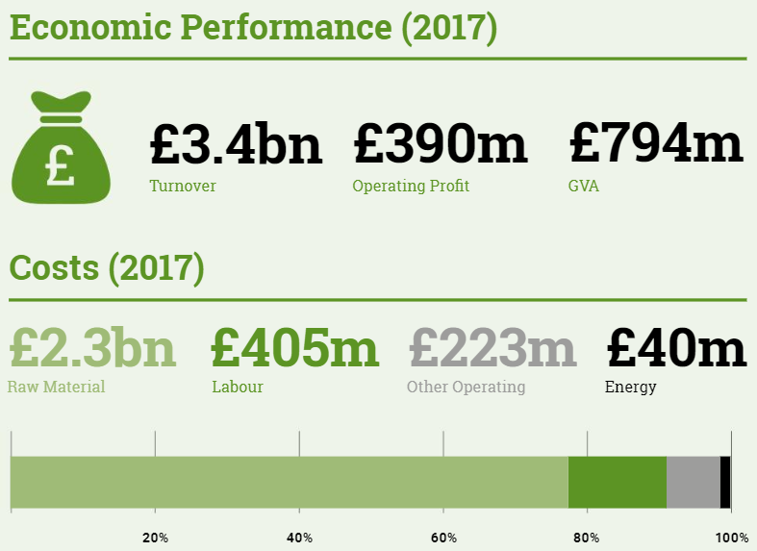
Fish processing industry
Source: Cutting edge report, Seafish

Slide 10
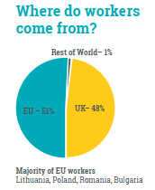
Employment & employees
Source: UK Seafood Processing Sector Labour reports, Seafish

Slide 11
Thank you for your attention
For further details contact:
Arina Motova
Chief Economist / Head of Economics team
Phone: 0131 524 8662
Email: arina.motova@seafish.co.uk
seafish.org.uk

